Slide 1




User
WAN
Data Center
Fraction in WAN
Fraction in DC
eNode-B
WAN
test point
hotspot
(USB)
Cellular Backbone
AT&T Backbone

Slide 2
Resolve:
qid.myAddr.mydomain.com
Resolve:
qid.myAddr.mydomain.com
myAddr
1
ns.target1.com
(target 1)
ns.target2.com
(target 2)
DNS Client
6
8
NXDomain
Referral:
ns.target2.com
DNS Server
5
NXDomain
4
7
Resolve:
qid.myAddr.mydomain.com
2
Resolve:
qid.myAddr.mydomain.com
ns.mydomain.com
Referral:
myAddr
5
8
Record time delta T between and
Determine RTT between myAddr and target1
Latency target1 to target2 = T – RTT
the time between and
3
6
7

Slide 3
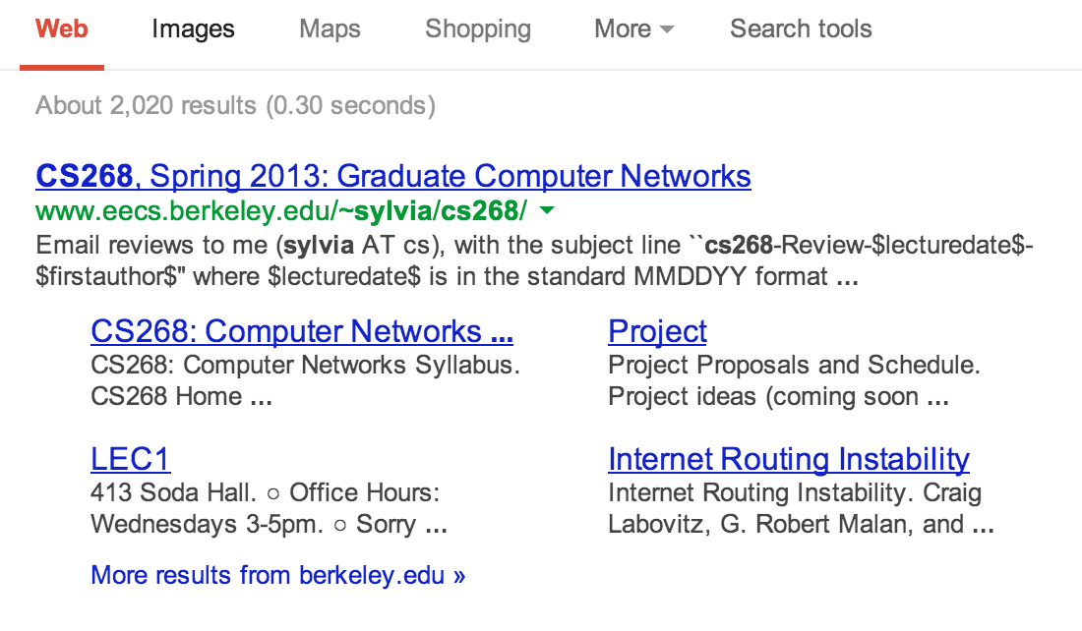

Slide 4

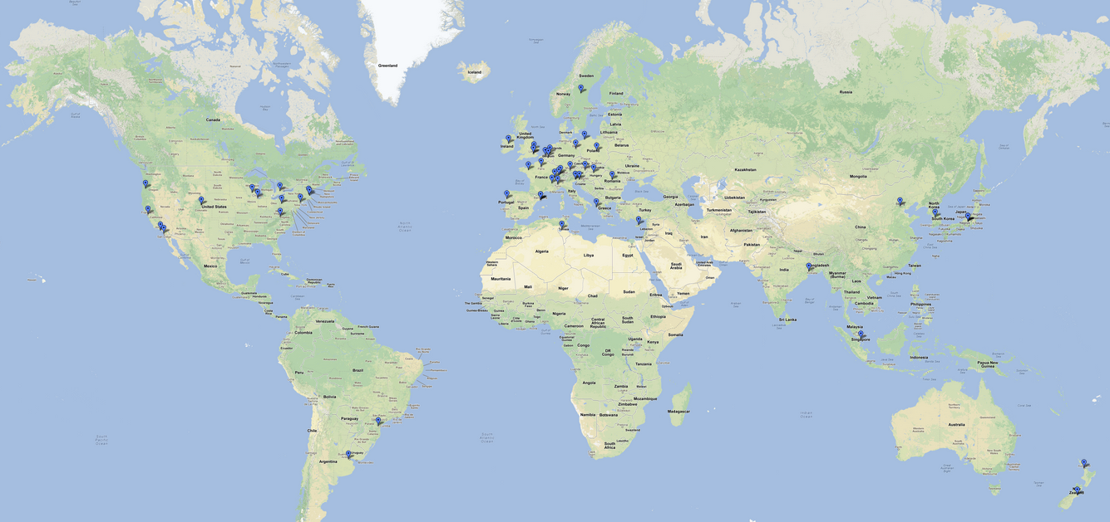

Slide 5
